Slide 1


Mobile Application Development
Business, design, and technology perspectives

Slide 2
Session A - Introduction
Agenda:
Introduction
Demo
Course Objectives
Course Structure
Why Mobile Apps?
Major Technologies
Components of a Mobile App
Frontend Structure
Frontend Architecture
Build Our First Page
Next Session

Slide 3
Introduction
Tooraj Helmi
I am also a trojan! I have engineering degrees in CS, EE, IE, and MBA from USC
I also have a PhD Econ from Suffolk University in Boston
I have 17 years of experience in software development, architecture, and management
I am an entrepreneur, have founded one startups and have advised a few startups

Slide 4
Course structure
4
TAs, Graders, Office Hours
Class Format (Lecture, Classroom Discussions, Semester Overview,
Ask Questions!
Grading (Quizzes, Exams, Homework, Project)
Requirements (Pre-reqs, You need to have a Mac)

Slide 5
THE CLASSROOM project, CommunityMEDIA: A community-based social platform
Problem: As a professional, I’d like to engage with other people to share ideas, have a dialogue on specific topics. Existing social media does not allow that.
Solution: Community-media, people join specific communities like medicine, engineering, politics, art, … and share and see content specific to those communities.
Professional
 |  |  | Community Media
 |  | LinkedIn 260m
 | Instagram 1b | Twitter 330m
Facebook 2.4b | TikTok 800m
User Professionalism
Casual
Generic Opinion
Specialized Facts
2
Content Specialization

Slide 6
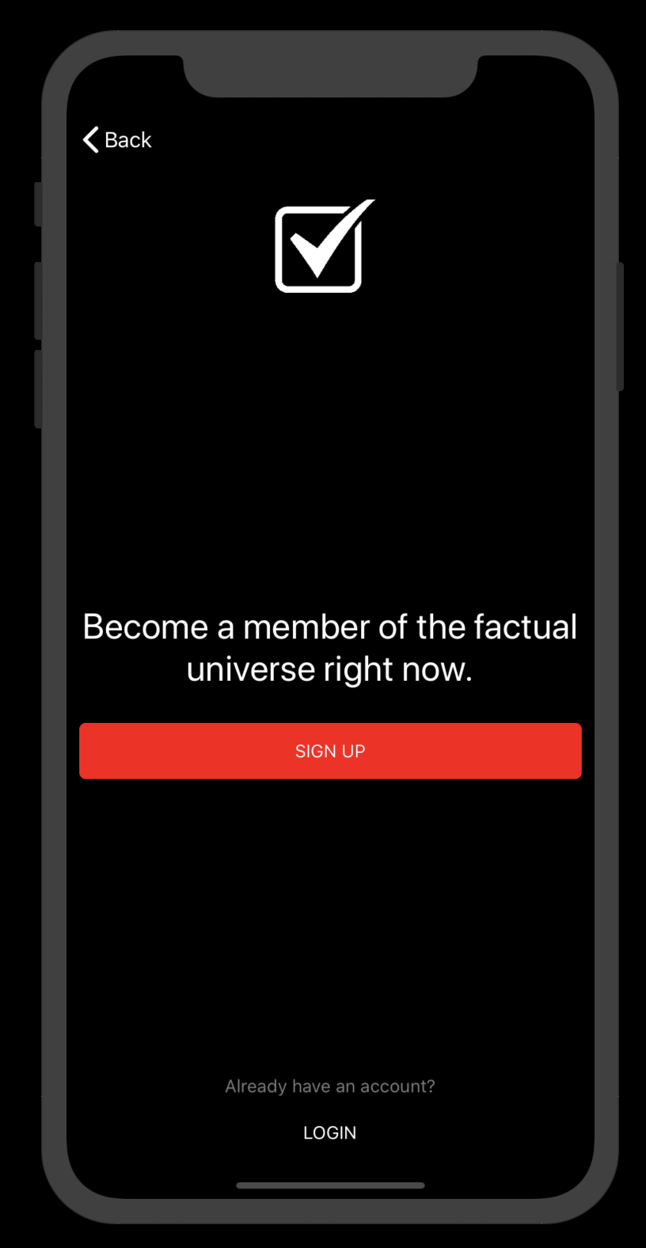
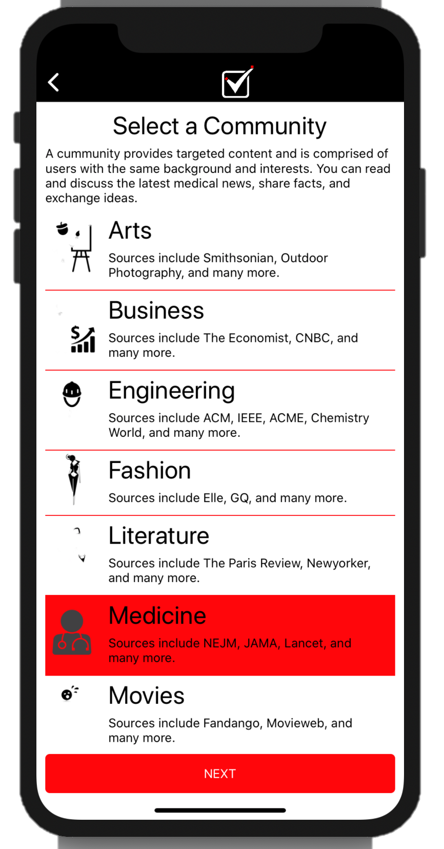
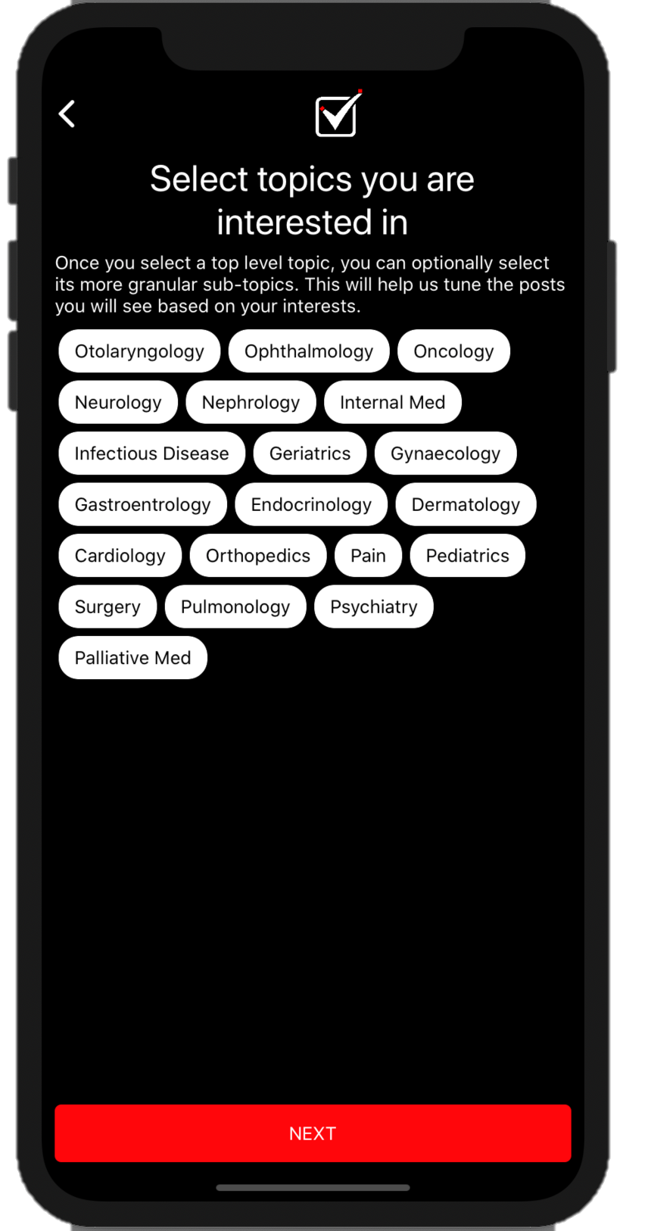
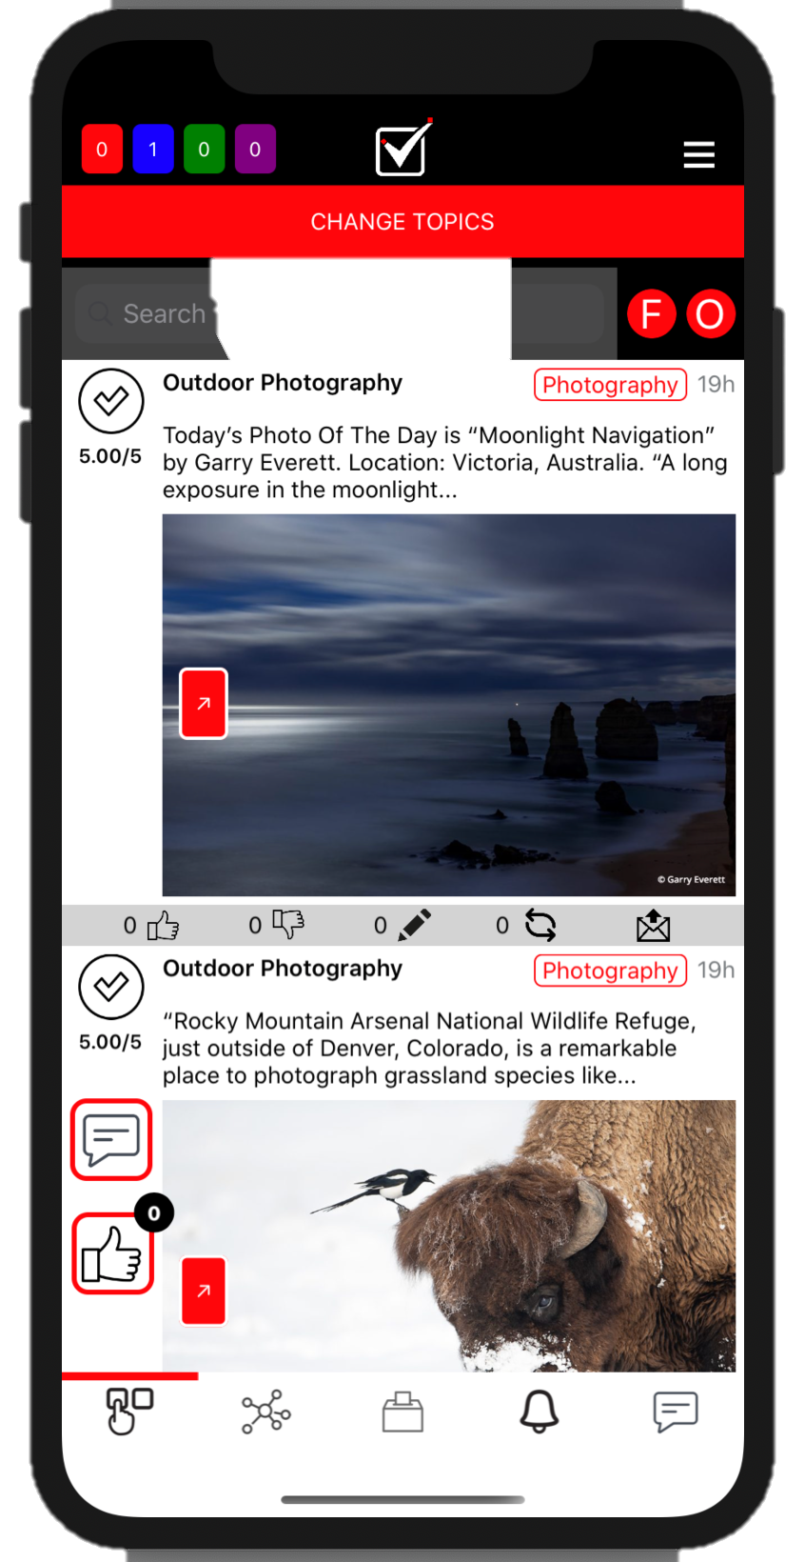
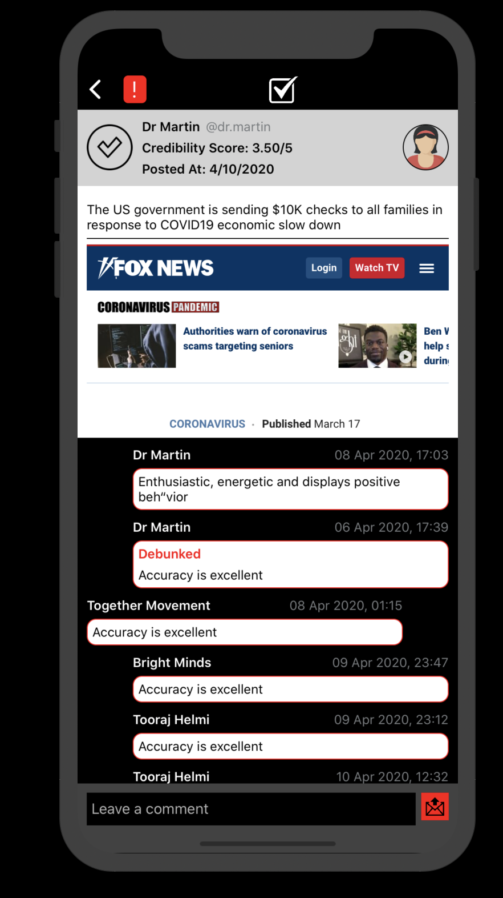
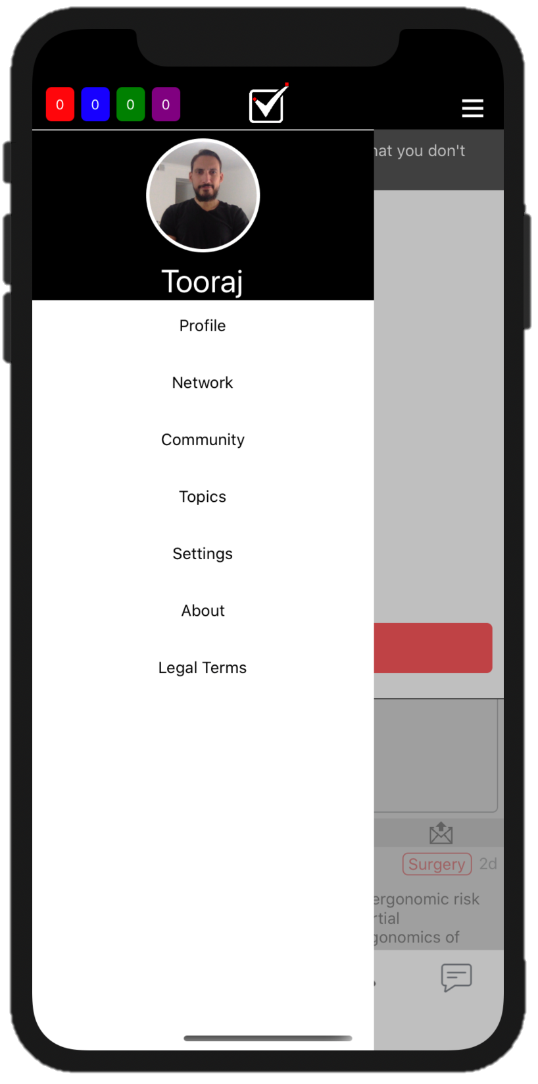
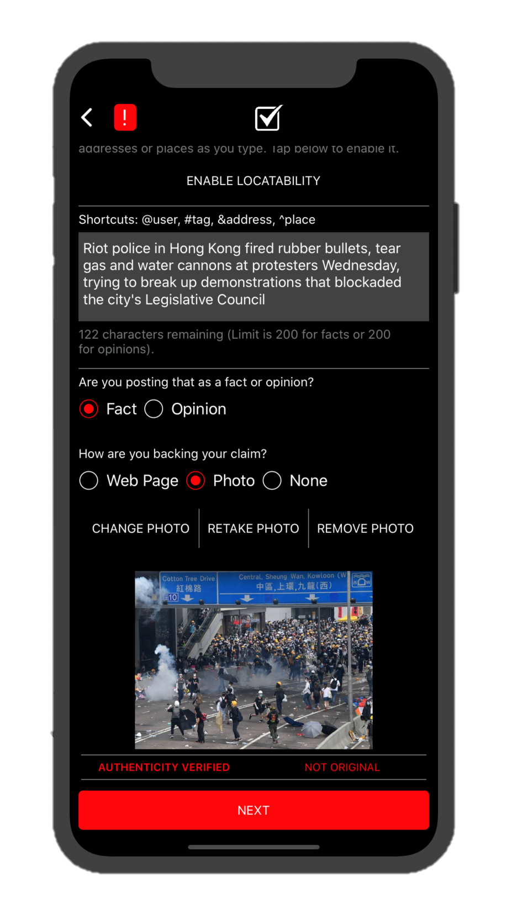
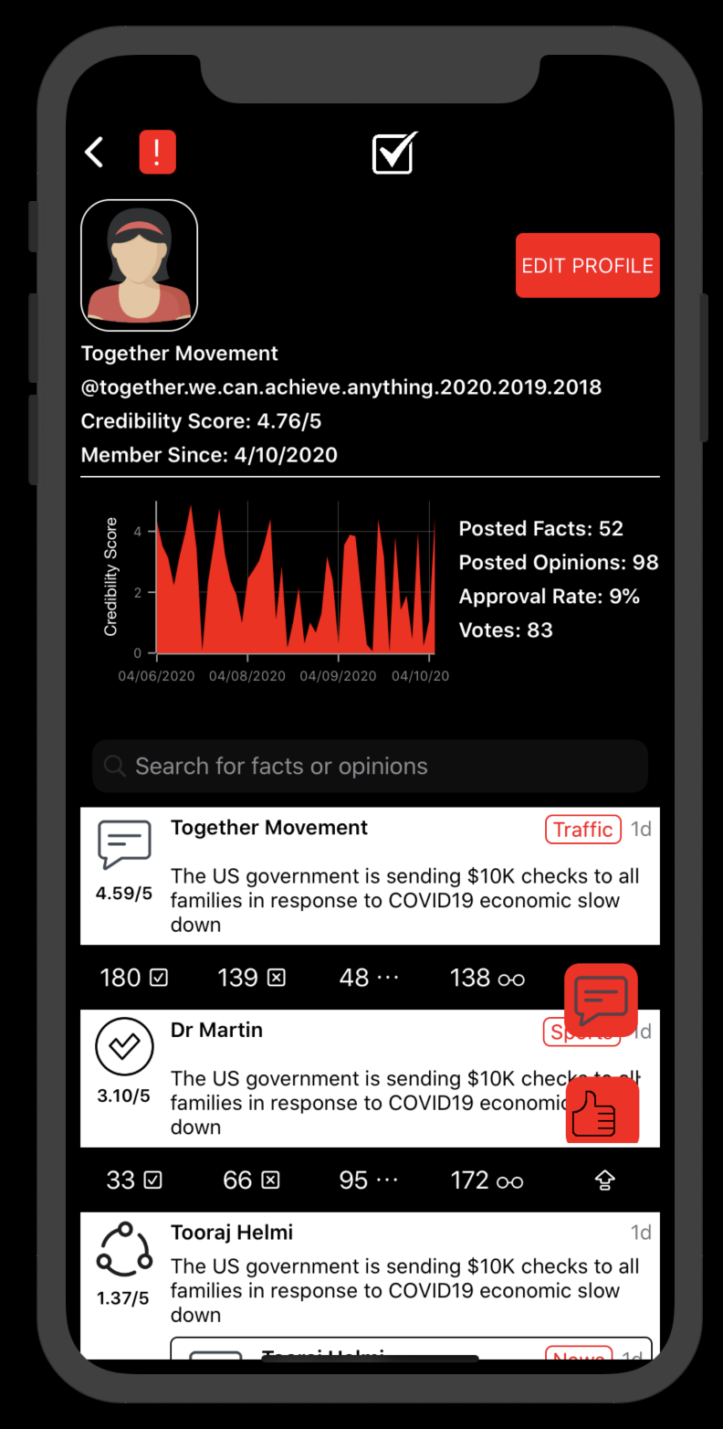
Community-Media Wireframes
 | Users can sign up by providing a valid phone number. |  | They can join one of the communities like medicine, technology, arts, politics, … |  | They can select a topics with that community |  | Once logged in they can see facts & opinion make by their connections or based on topics |  | They can interact by poster by leaving a comment, debunk, share, or vouch for the post
 | Menu allows user to update profile, connections, settings, and interested topics |  | A claim can include specific auto-suggested tags based on users, addresses, places, and topics. It can be be backed by a web or a photo source. The source is fact-checked right-away using AI and if passes will go through a voting process. |  | Users can see their posted facts and opinions on the home page. They can also see how their credibility score has changed over time
1
2
3
4
5
6
7
8
1

Slide 7
Course objectives
Identify the problem we are solving
Identify the right technology solution for it
Create a pitch deck
Design the application wireframes
Develop the app
Deploy the app
Monetize the app
3

Slide 8
Why DO We Create Mobile Apps?
2017 Mary Meeker report
5

Slide 9
MAJOR technologies USED FOR MOBILE DEVELOPMENT
Native
iOS
Android
Cross-platform
Xamarin (Microsoft), 2013
Easy to pickup, mature tooling, abundant 3rd party component providers, one language for everything (C#)
UPS, Alaska Airlines
React Native (Facebook), 2015
Is preferred if web is also required, requires different skillsets (JavaScript, CSS, Node.js), better integration with design tools like Sketch
Facebook, Instagram
Flutter (Google), 2017
Newer technology, less resources available on the web
Square, New York Times
6

Slide 10
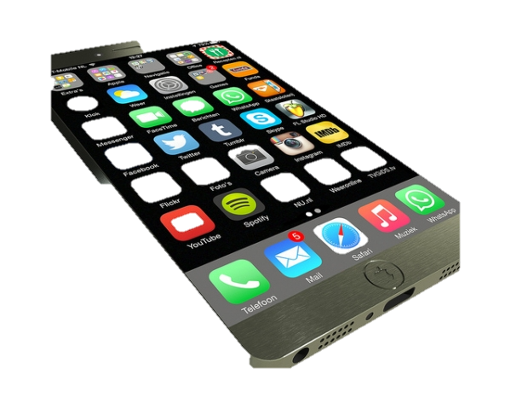
Different components of an end-to-end mobile application
7
What is it? | Where is it?
Front-end Interaction Logic User Interface (UI) | Mobile
Back-end Databases API | Cloud
Backend
Cloud (AWS, Azure, Google Cloud)
API (Application Programming Interface)
API
Post/Get Users
Post/Get Posts
…
Frontend
Data

Slide 11


APP Front-End Structure
Shared Code 98%
iOS 1%
Android 1%
8

Slide 12
MVVM (Model-View-View model) Architecture
Shared Code 98%
Views
Launch View
Login View
Signup View
Posts View
…
View
Models
Services
Launch ViewModel
Posts ViewModel
…
Models
User Model
Account Model
Post Model
…
iOS 1%
Android 1%
9

Slide 13

Let’s Build the first screen
Login to engage with your community
Username
Password
LOGIN
Can’t remember your username or password?
GET HELP
Classroom Coding A.1
Build the UI in Visual Studio
(30 Min)
10

Slide 14
Prep for the Next Session
Join teams (4 person per team)
TA will randomly select the team you will be part of
Homework: Select a problem you want to solve as a team
Meet with your team and identify a problem you want to solve
Write your problem – one paragraph
What is your solution to that problem – one paragraph
Do some research on what other solution exists that are like yours. Try to list 3 or more players with their website. Explain how your solution is different from those.
Submit a page that includes all the information above
Be ready to explain your problem for the entire class
Next session
Pitch-deck structure
Walk you through how to create wireframes for your app.
More frontend topics: Defining UI Interactions, Creating ViewModels & Models
11

Slide 15
Session C2
Building the App - front-end Foundations, UI Interactions

Slide 16
Business Pitch Deck
Problem (Pain)
Solution
Market size and segmentation: # of users, $ user spending, demographic
Go-to-market strategy: How to reach out to our customers and convince them to start using our solution
Business model: how do we make money
Founding team: why this team is the perfect team to make this happen? How the team members know each other
Financial prediction: Revenue, profit, LTV, CAC, …
Competitive Analysis

Slide 17
Session C3
Building the App - front-end Advanced Topics: styling, Navigation, asynchronous tasks

Slide 18
Phases in App Development
UI Prototyping
Local Development
Local MVP
Real MVP
Deploy for Testing
Publish to App Store

Slide 19
Session D1
Building the App - Back-end Foundations

Slide 20
Session D2
Building the App - Back-end Advanced

Slide 21
Session E
Building the App end-t0-end

Slide 22
Session F
Building the App - Debugging techniques

Slide 23
Session G
Building the App - Deploying the App for testing

Slide 24
Session H
Building the App - publishing the app

